Slide 1

Wakeman Heights Performance Summary 2022

Slide 2
Contents
Executive Summary
Key findings
Solution
Recommendation
Conclusion

Slide 3
Executive Summary
Based on the company's provided sales data, our financial position is as thus
the company's financial performance is reported in this presentation.
Total revenue generated is N22.8 million over a period of 12 months.
N18.6 million in operating expenses with a Actual Net Cash of (N4.2million).
Projection Net cash of (-N3.7million) which leaves the company with a (–N3.6million) Recovery on projected loss with a viability index of N1.2.
Eight product categories—Private office, Cowork, Office space, virtual office, Business address, Boardroom, Training room & meeting room —along with a number of subcategories are responsible for this profit. Four sales channels were used to disperse the sales.
Based on the Private office, virtual office, Cowork & meeting room, the data in this presentation was evaluated.

Slide 4
KEY FINDINGS

Slide 5
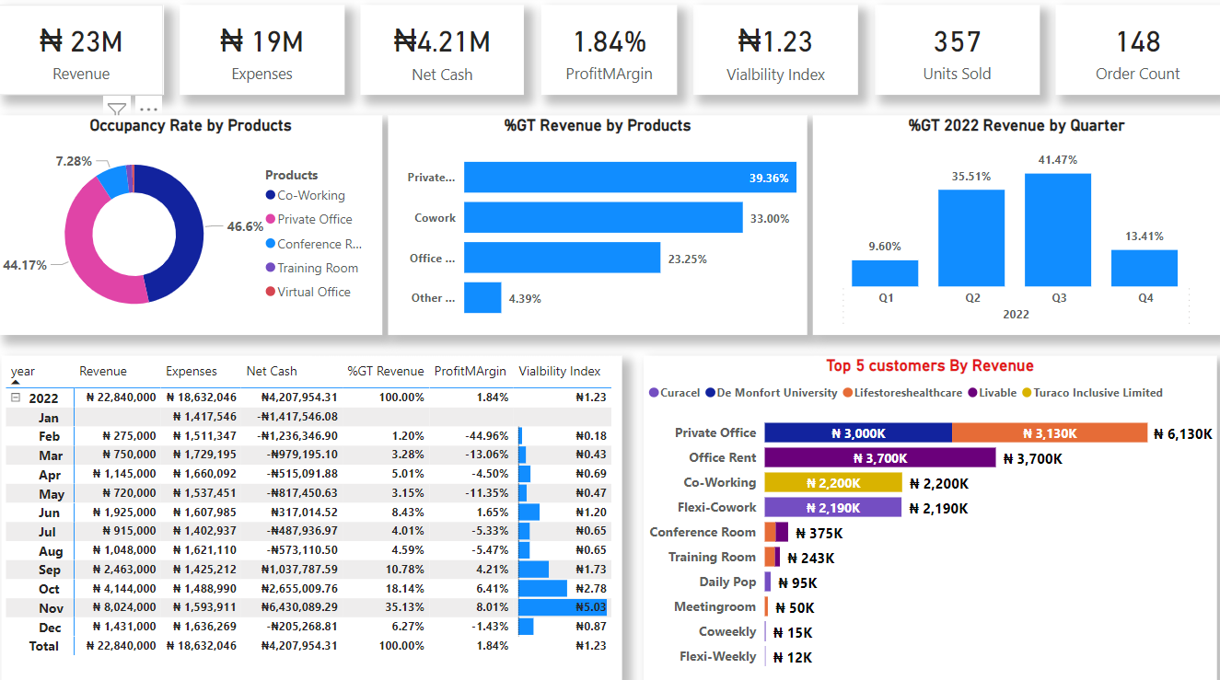

Slide 6
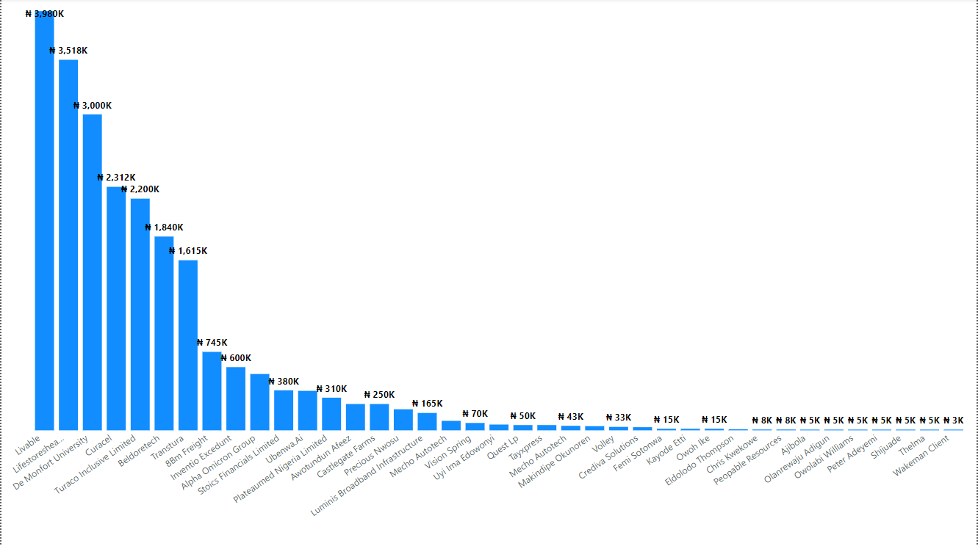
Revenue generated by Customers for the year 2022

Slide 7
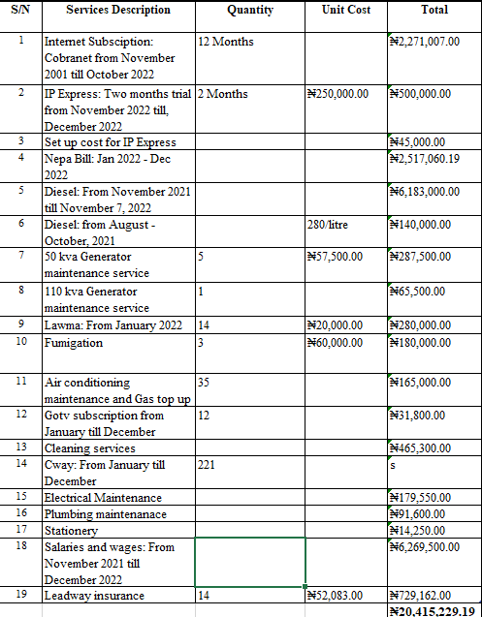
The underlisted are the Expenses summary for WH from November 2021 till December 2022.
This data was gotten from the facility Unit.
Summary description
(1) WH subscribes to Cobranet, 7mbps from November 2021 till November 2022. However, we increased from 7mbps to 20mbps in March 2022 and the subscription was on till November 2022.
(2) IP express was suggested for WH since it is fibre and it more efficient & relaible than cobranet. Thus, we subscribe to IP express for a two month's trial,November and December 2022. IP express was impressive and clients are enjoying our internet service.
(6) Diesel Purchased in 2001 was used in running the facility during construction before operation commenced in November, 2021
(10) Fumigation exercise were carried out three times in the year, 2022
(11) Thirty five (35) Ac’s were serviced in the Year, 2022.

Slide 8
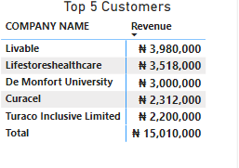
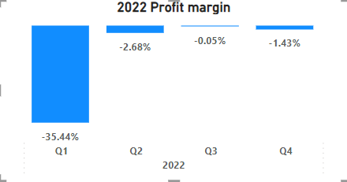
Key Findings
The Q3 has the highest Revenue with a (41.70%) & the Q1 with the least revenue of (9.6%).
A negative 0.05% profit margin in the Q3 indicates that the company is losing very little money relative to its revenue, while a negative 35.44% PM in Q1 indicates that the company is losing a significant amount of money relative to its revenue.
The product,Private Office has generated (39.36%) with the highest Revenue with a (44.17%) occupancy rate, whereas other products(Meeting room, training room, virtual Office) with a (4.39%) has the least Revenue.
Livable & Lifestores Health care are the clients with the highest Sales of approximately (N7m).
The month with the highest Revenue generated is November(N8M) with a viability Index of (N5.03) & while February(N275K) with the least Revenue generated & viability Index of (N0.18).

Slide 9
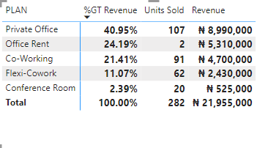
Performance Driver
The private Office product has being a major drive in generating revenue having Lifestores Pharmaceutical being a major contributor.
DMU subscribed to a yearly plan having the Private Office being the most unit sold.
Toraco Insurance subscribed to 15 unit of the Cowork with 45 units sold in total, while Curacel Insurance has been the major drive to the Flexi Cowork with 56 units been purchased in total.

Slide 10
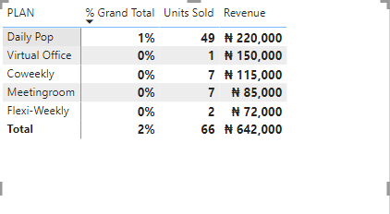
Solutions
Discounts & product promotion could be given to low performing plans.
The Flexi Weekly plan maybe discontinued if no sale is being made in the first Q1.
The virtual office & Business address could be a complimentary service for clients that subscribes for at least 3 months.
The meeting room could come as a coupon for subscription of the Virtual office.

Slide 11
Recommendations
Customer survey can be carried out to find out what clients need.
The just converted office space 301 to Private office could be returned to his former state if sales is not being made after the first Quarter of this year 2023.
The pod area could be converted into a private call room which would generate revenue for the company.

Slide 12
Conclusion
Analyzing the company's first year of financial performance, with a profit margin of 1.84%,a viability index of 1.23 and net cash of 4.2 million at the end of the year 2022 it can be considered that the company is to be operating at a marginal level of financially profitability and viability, but with a healthy cash position. However, the suggestions in this report can be used to improve performance in the future.

Slide 13
Team members
Kayode Makinde
Pelumi Adenekan
Oloyede Oyebode

Slide 14
Thank you!

Slide 15
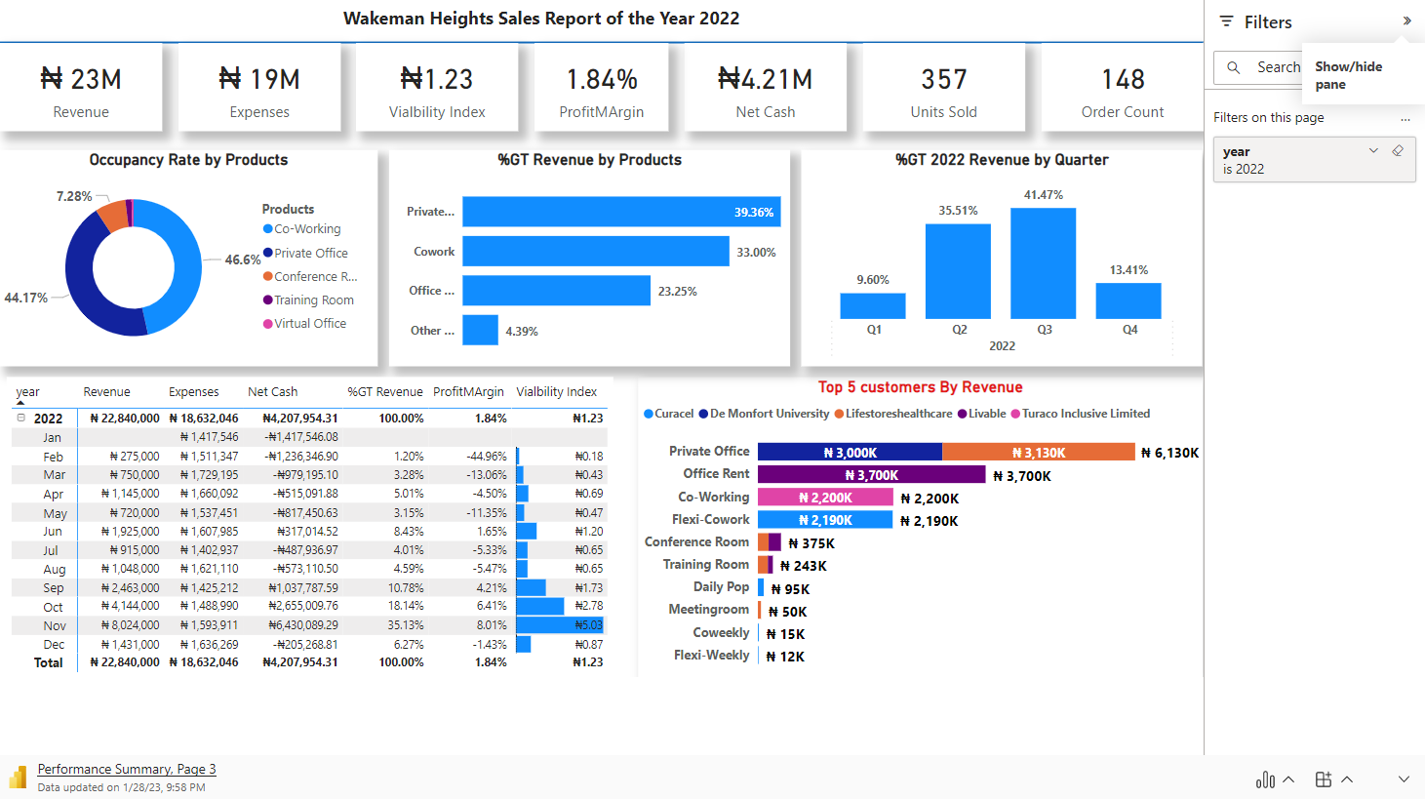
Thank you!

